Slide 1
The HIVE 5
CSE 406 : Computer Security Sessional
Presented By:
1805004 - Syed Jarullah Hisham
1805008 - Abdur Rafi

Slide 2
Introduction
Security Incident Response Platform
The Hive 5 for this project
Open source till The Hive 4 version
The Hive 5 limited features in community license
information security practitioner dealing with security incidents that need to be investigated thoroughly
Integration with other tools (MISP, Cortex etc) to automate the analysis process

Slide 3
Key Features
Multi-tenancy
TheHive comes with a special multi-tenancy support. It allows the following strategies:
organisations can be defined without allowing them to share data
a set of organisations can be allowed to collaborate on specific cases/tasks/observables, using custom defined user profiles (RBAC).
Role Based Access Control
admin: full administrative permissions on the platform ; can't manage any Cases or other data related to investigations;
org-admin: manage users and all organisation-level configuration, create and edit Cases, Tasks, Observables and run Analyzers and Responders;
analyst: create and edit Cases, Tasks, Observables and run Analyzers & Responders;
read-only

Slide 4
Key Concepts
Organization
Create and edit organization, create users and organization admins
Cases
Create and manage different cases based on any incident
Tasks
Create and assign some tasks based on cases and generate feedback from assigned users
Observables
Observe the severity or match with any previous incident and thus generate report
Integration
Integration with other security platforms like MISP, Cortex, Wazuh etc

Slide 5
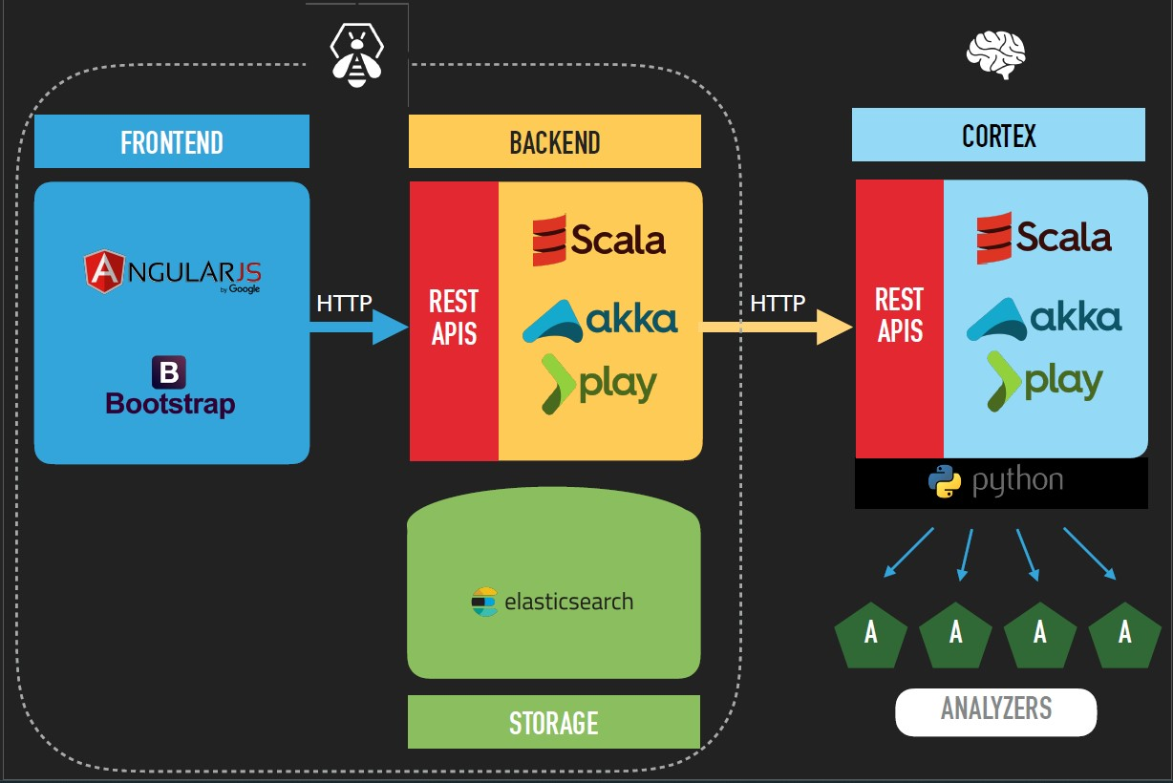
Architecture

Slide 6
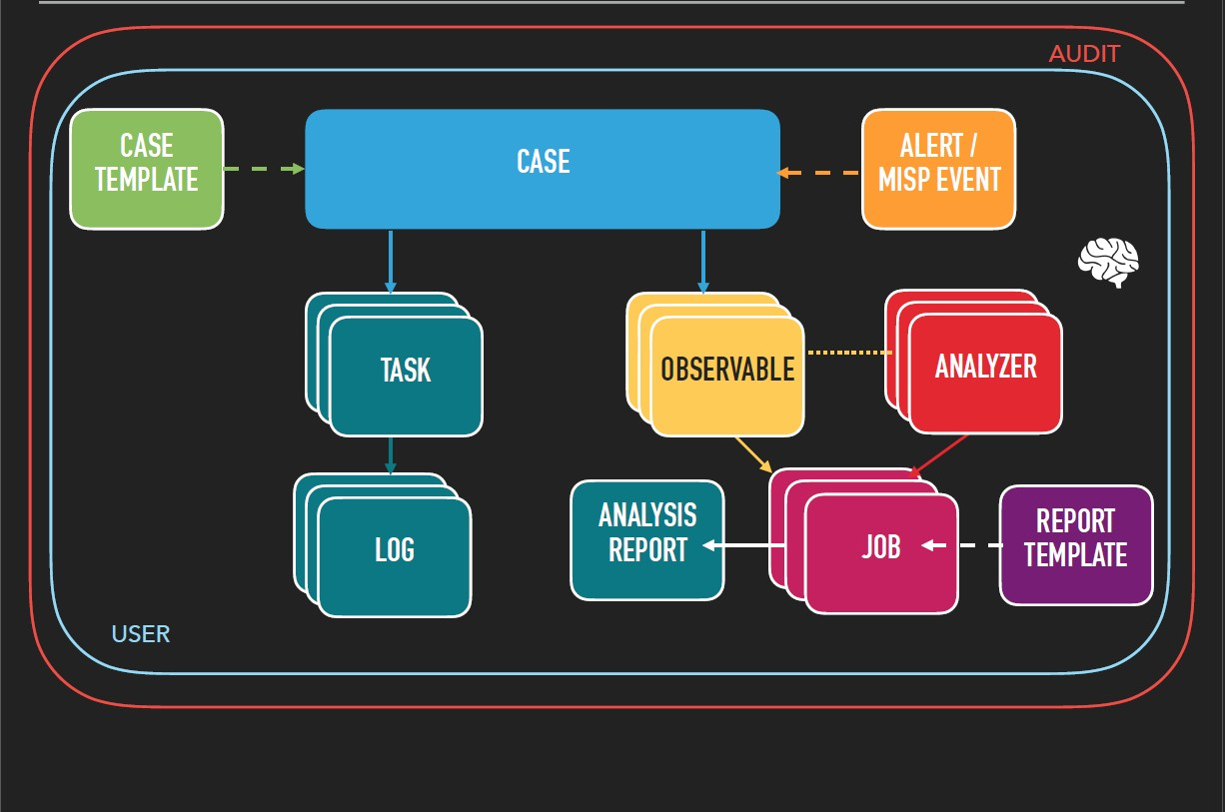
WorkFlow

Slide 7
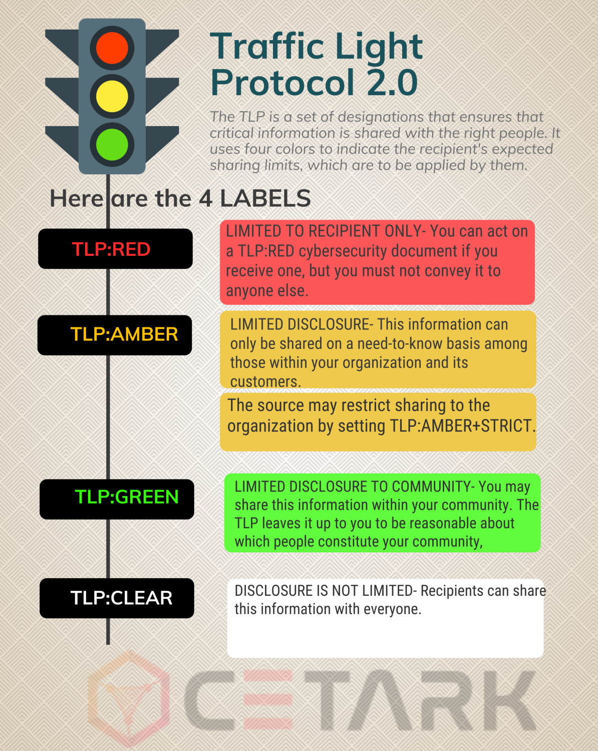
TLP

Slide 8
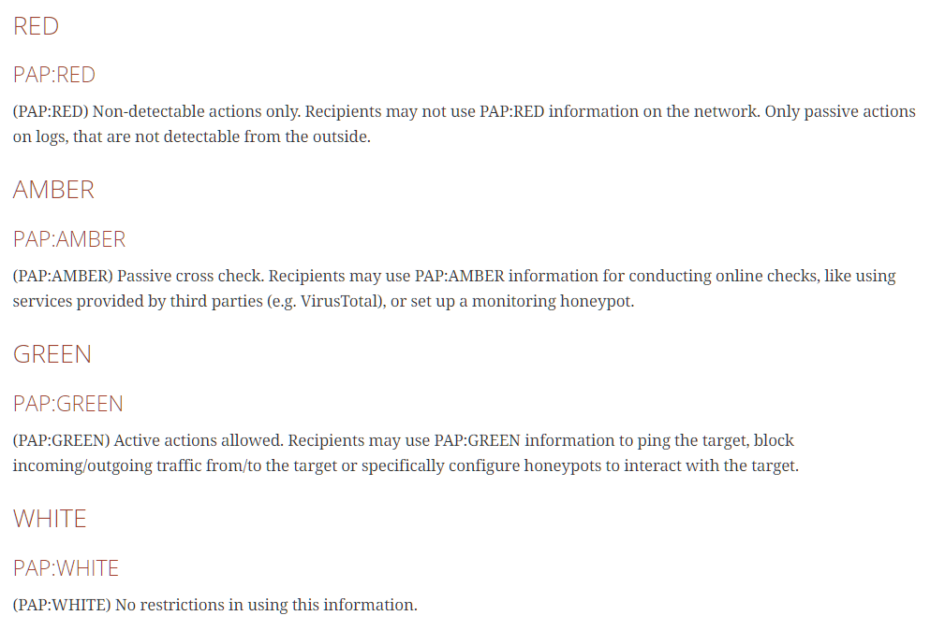
PAP

Slide 9
Demo Feature Part I
Cases and Observables

Slide 10
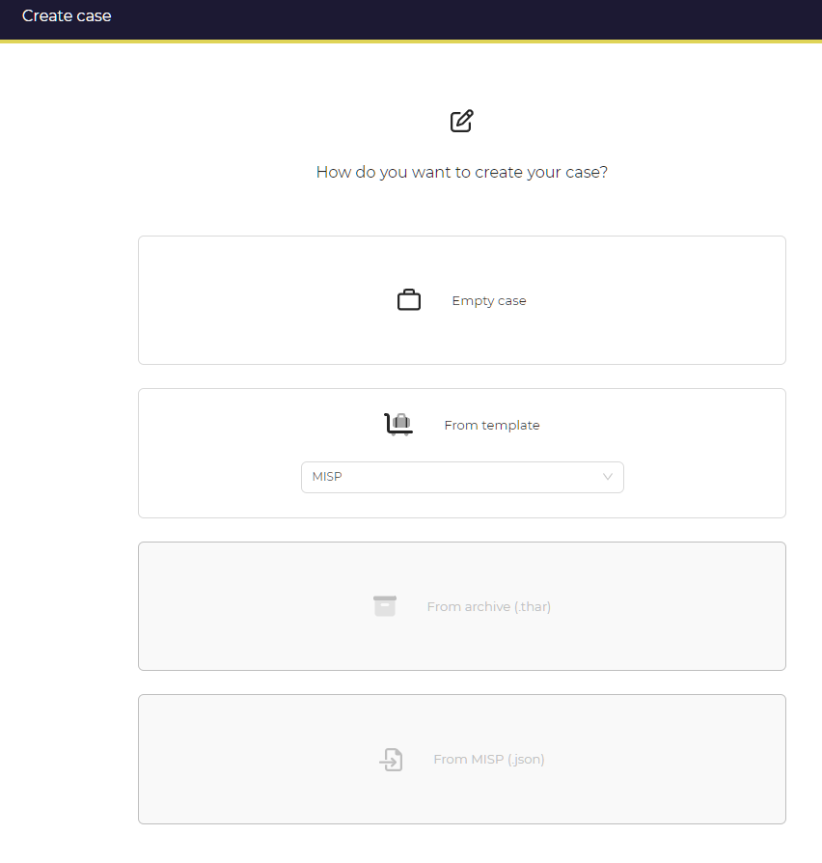
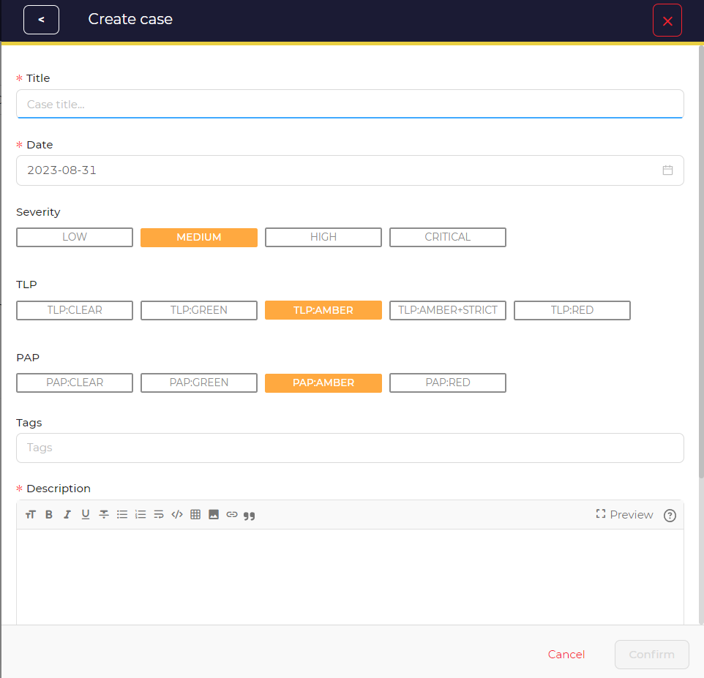
Case Creation

Slide 11
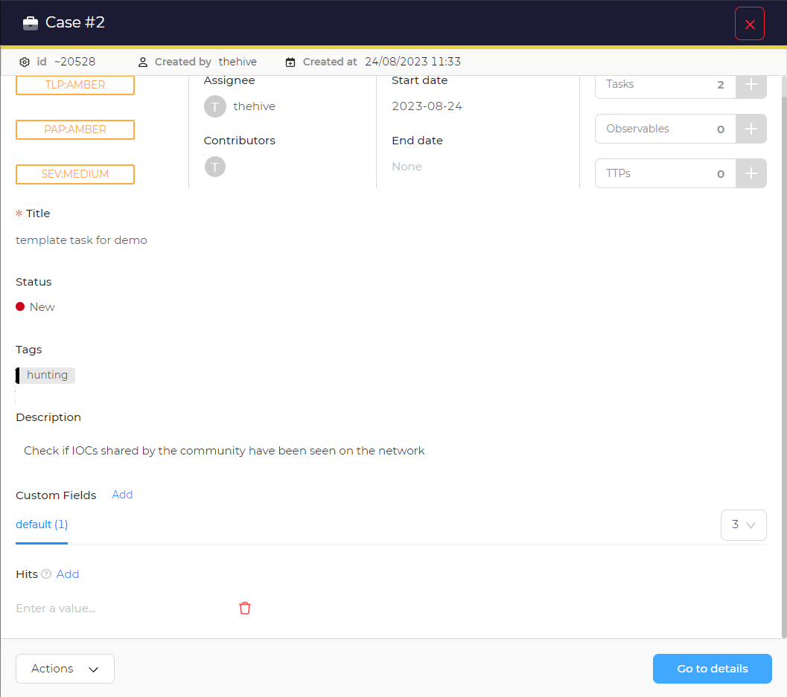
Case Preview

Slide 12
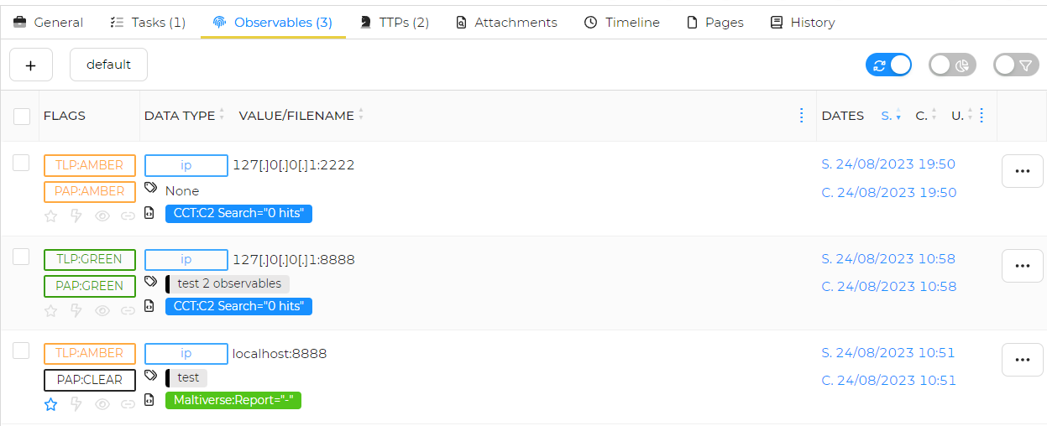
Observables

Slide 13
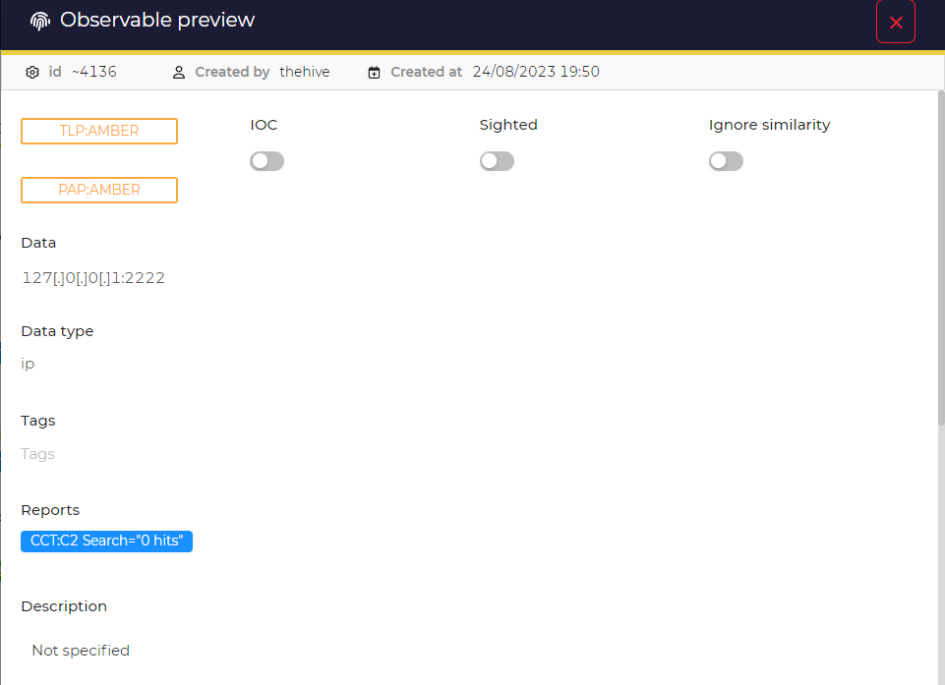
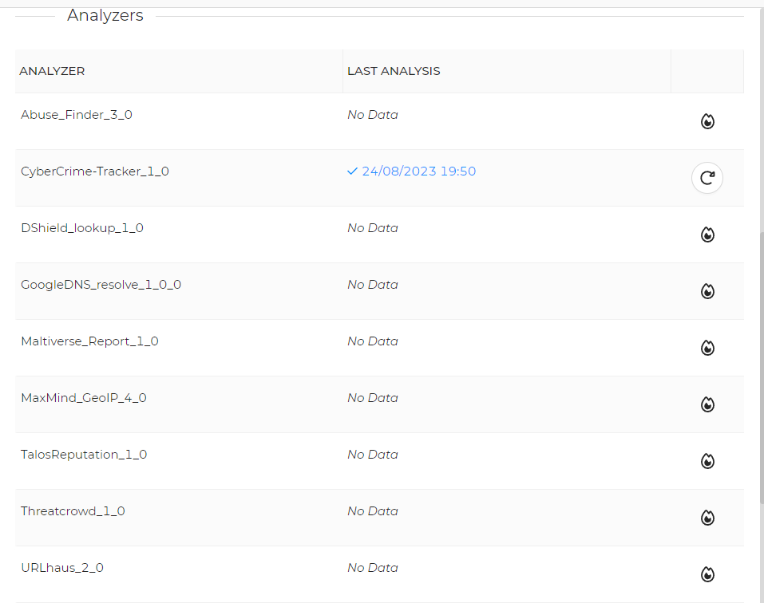
Preview
Analyzer

Slide 14
Demo Feature Part II
Cortex Integration: Analyzer and Responders

Slide 15
Integration With Cortex
Cortex provides 2 things:
Analyzers
Responders

Slide 16
Analyzers
A program that take an observable (eg. ip address, hash, file etc) as an input, analyzes it and produces result describing its findings
Analyzing an ip address may involve checking if any suspicious activity has been seen from it before.
Analyzing a file may involve checking for signatures of any known virus

Slide 17
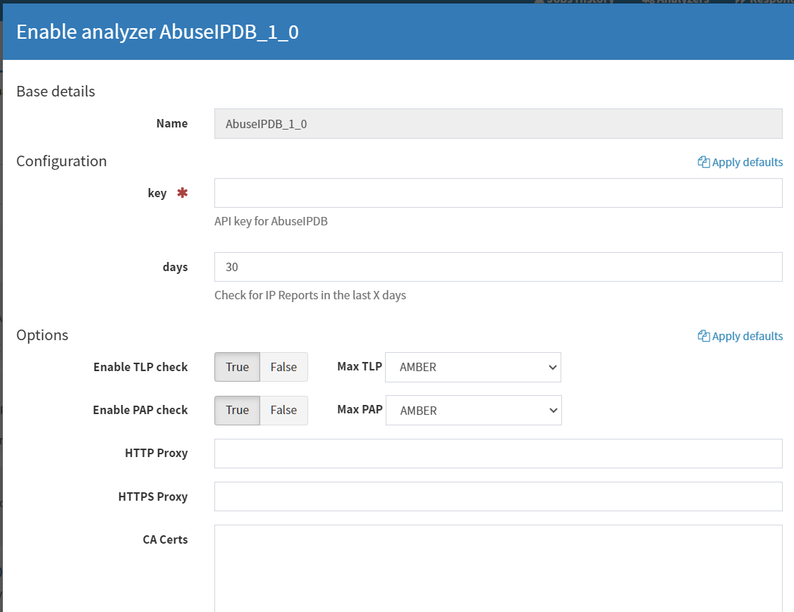
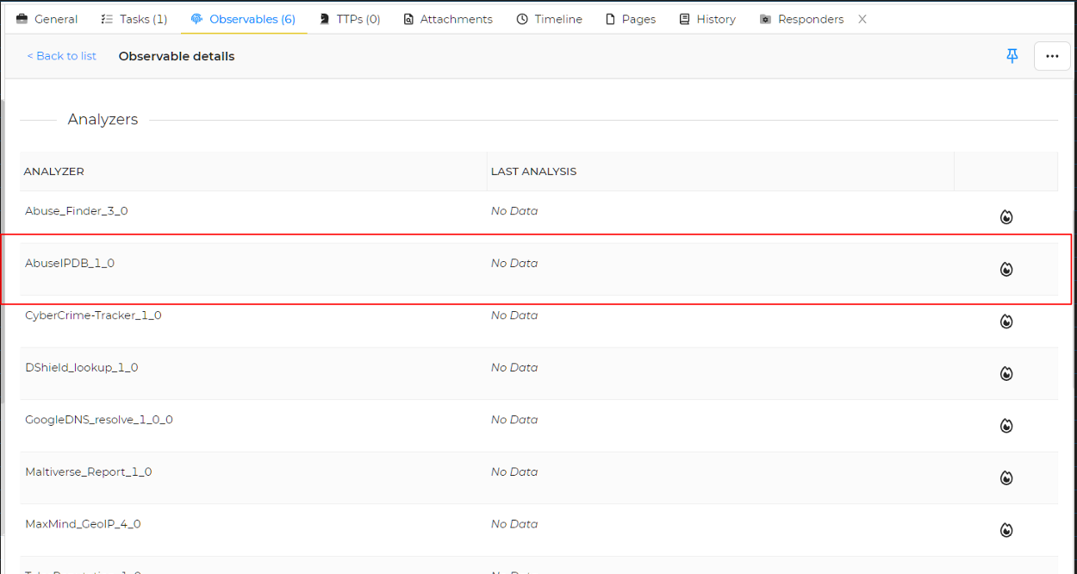
Add Analyzers

Slide 18
Responders
A program that performs some actions based on an alert, task, or observables.
A responder for an ip observable may add entry to a firewall to block that ip.
A responder on a case may send detailed status information of a case to some predefined mail addresses.

Slide 19
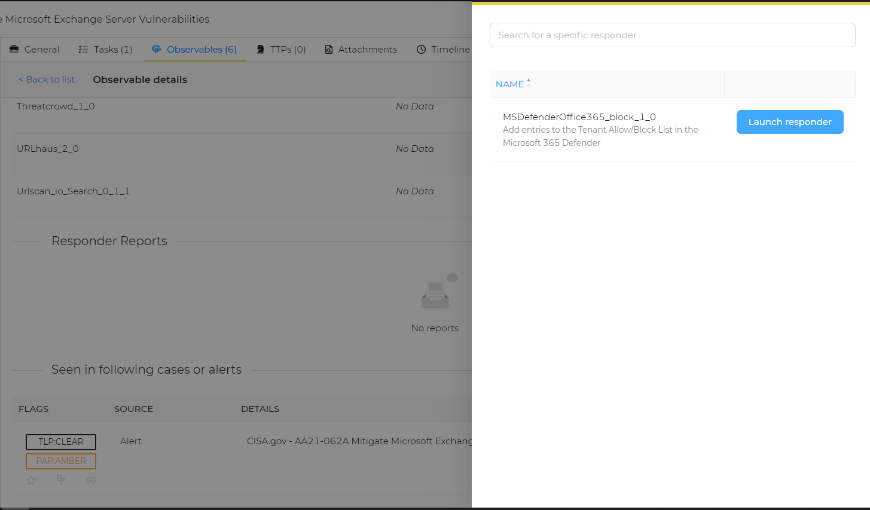
Responders

Slide 20
Thank You

